Slide 1



ERASMUS+ project „Strengthening the eHealth literacy skills of older adults” 2025-1-EE01-KA210-ADU-000356010 26.09.2026, Tallinn, Estonia Ruta Pels, Eesti People to People

Slide 2
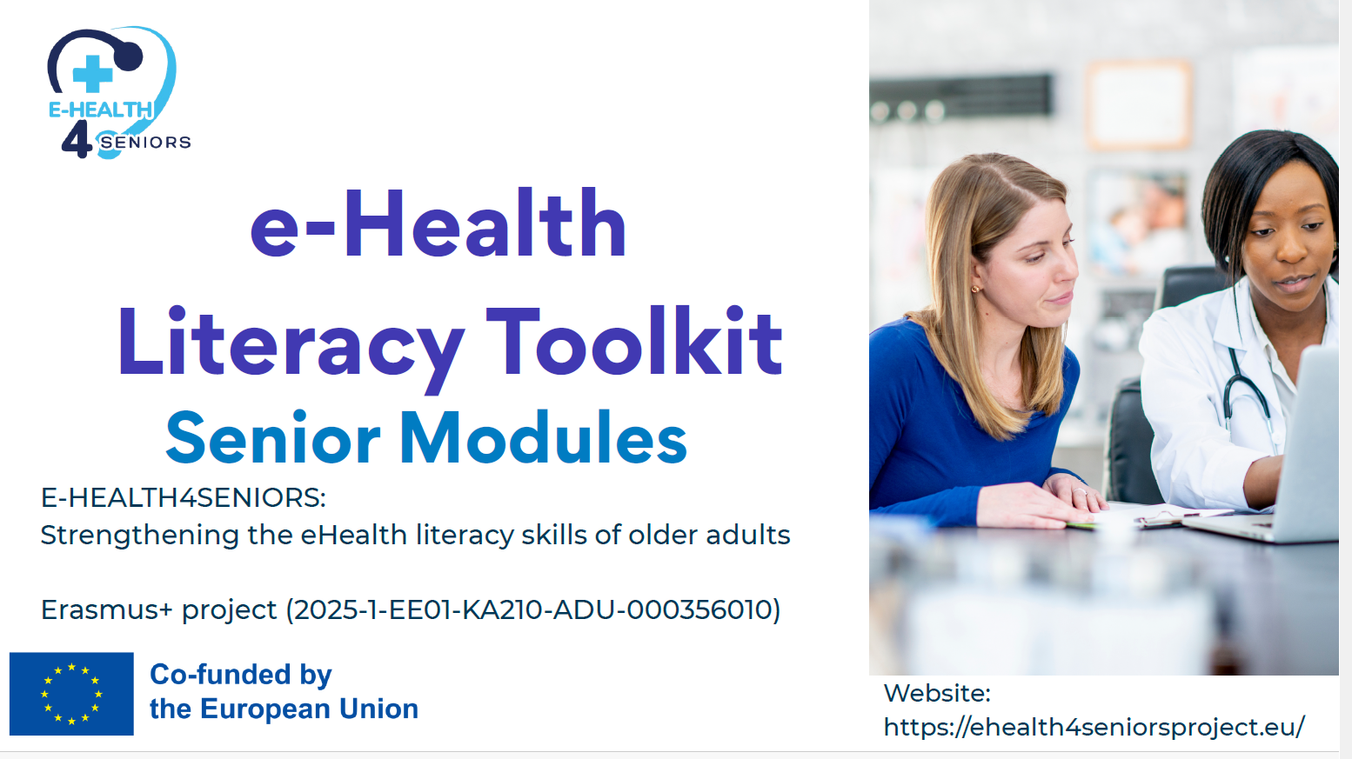

Slide 3


Slide 4
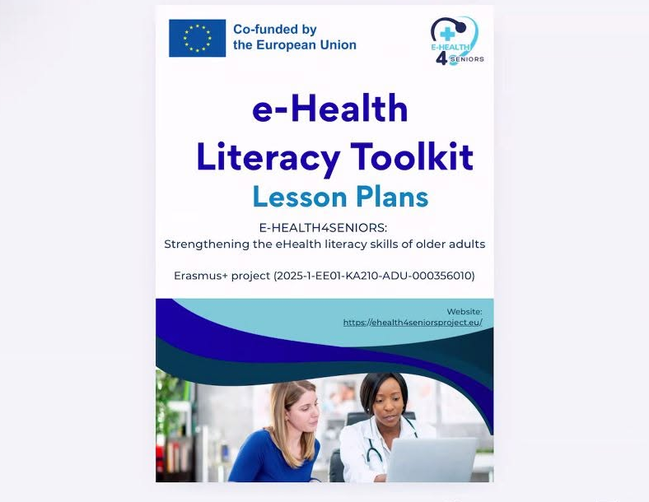

Slide 5
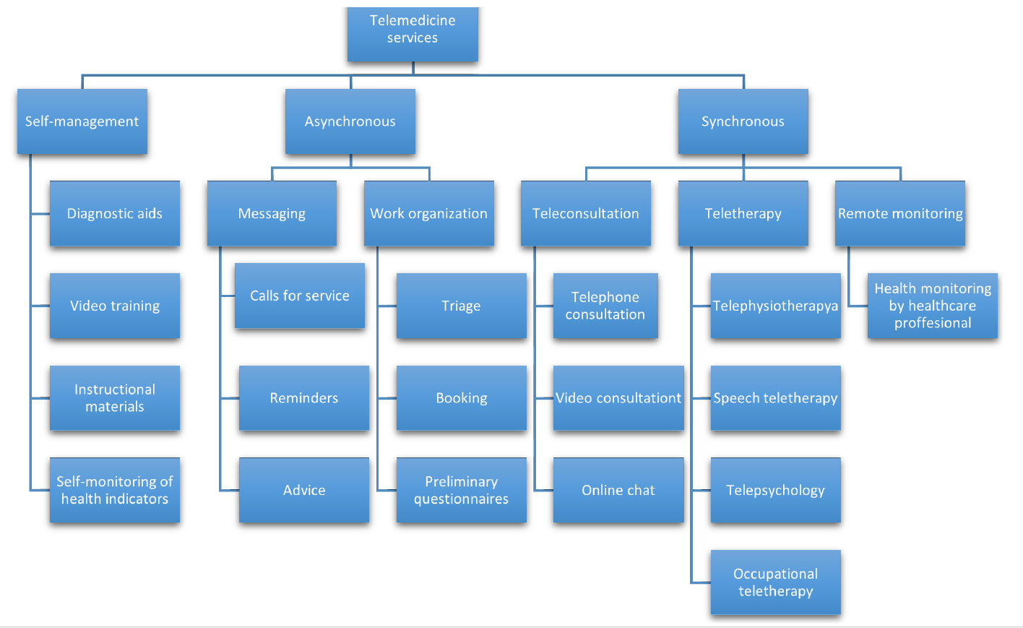

Slide 6
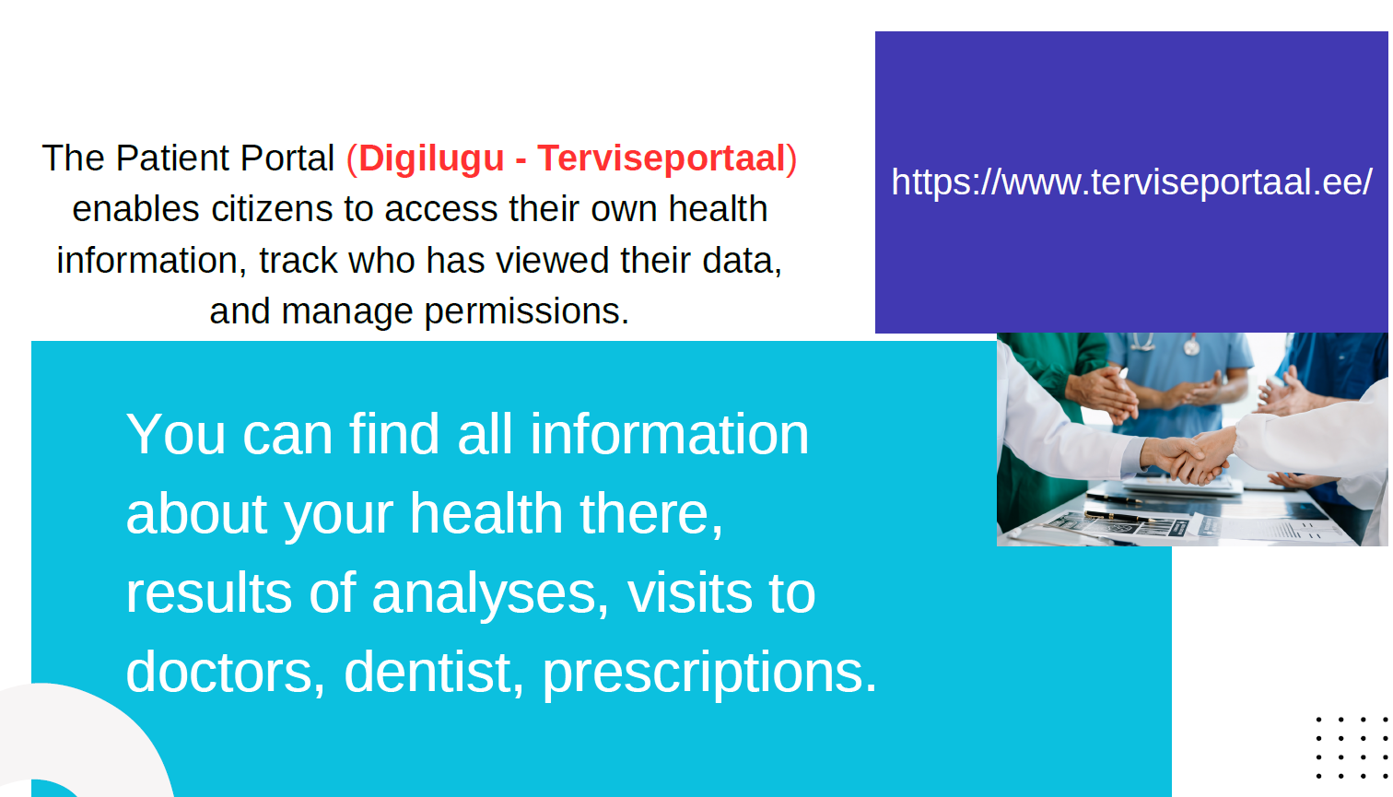

Slide 7
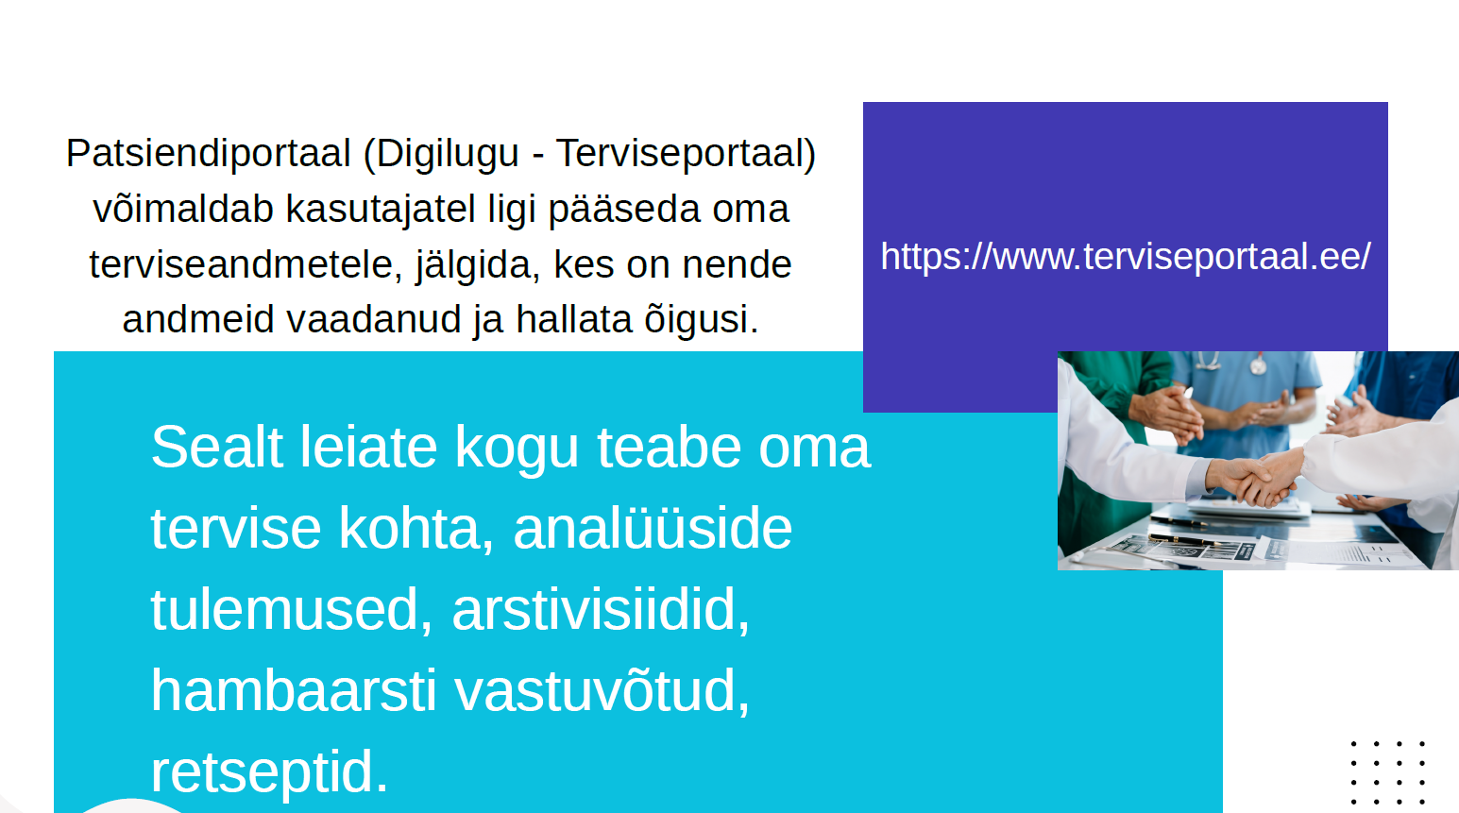

Slide 8
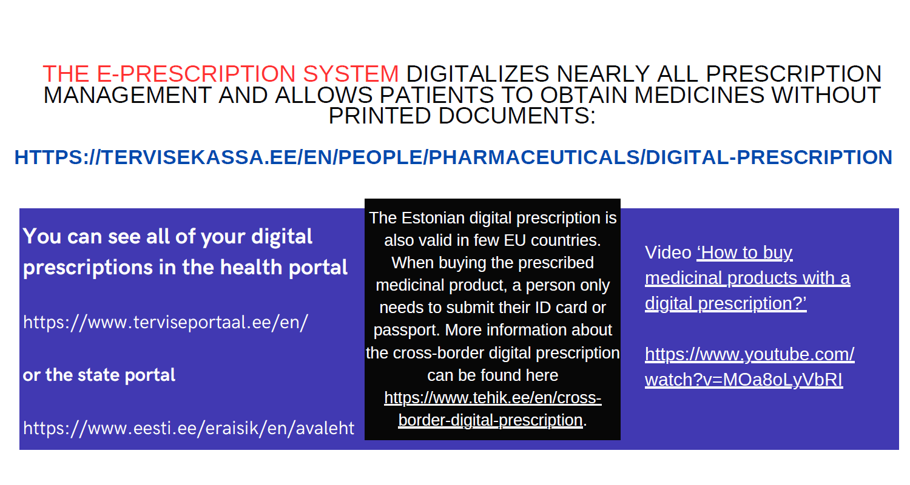

Slide 9
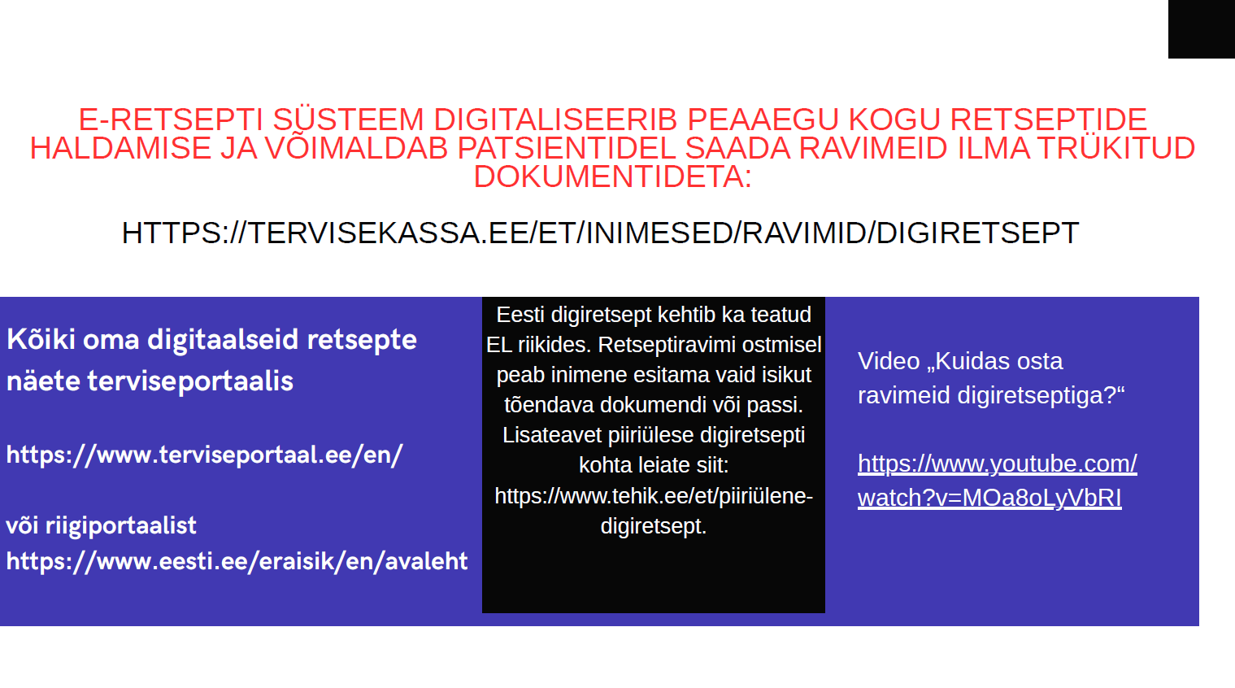

Slide 10


Slide 11


Slide 12
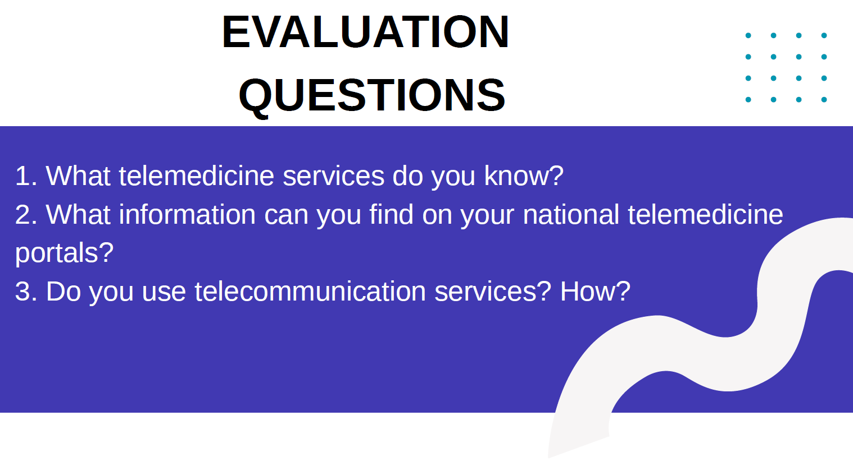

Slide 13
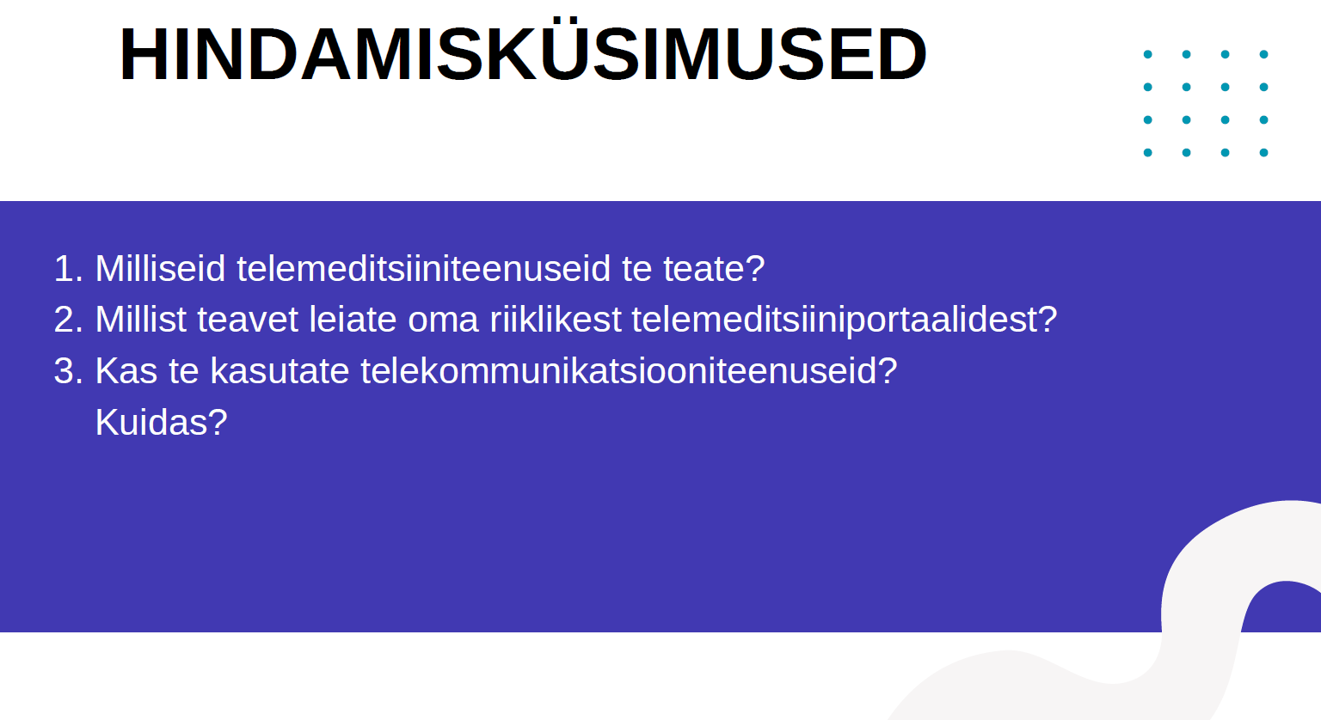

Slide 14


Slide 15
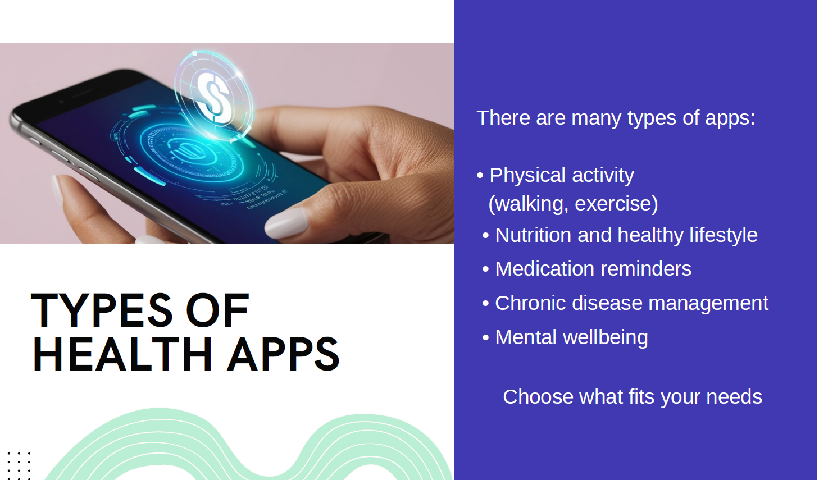

Slide 16
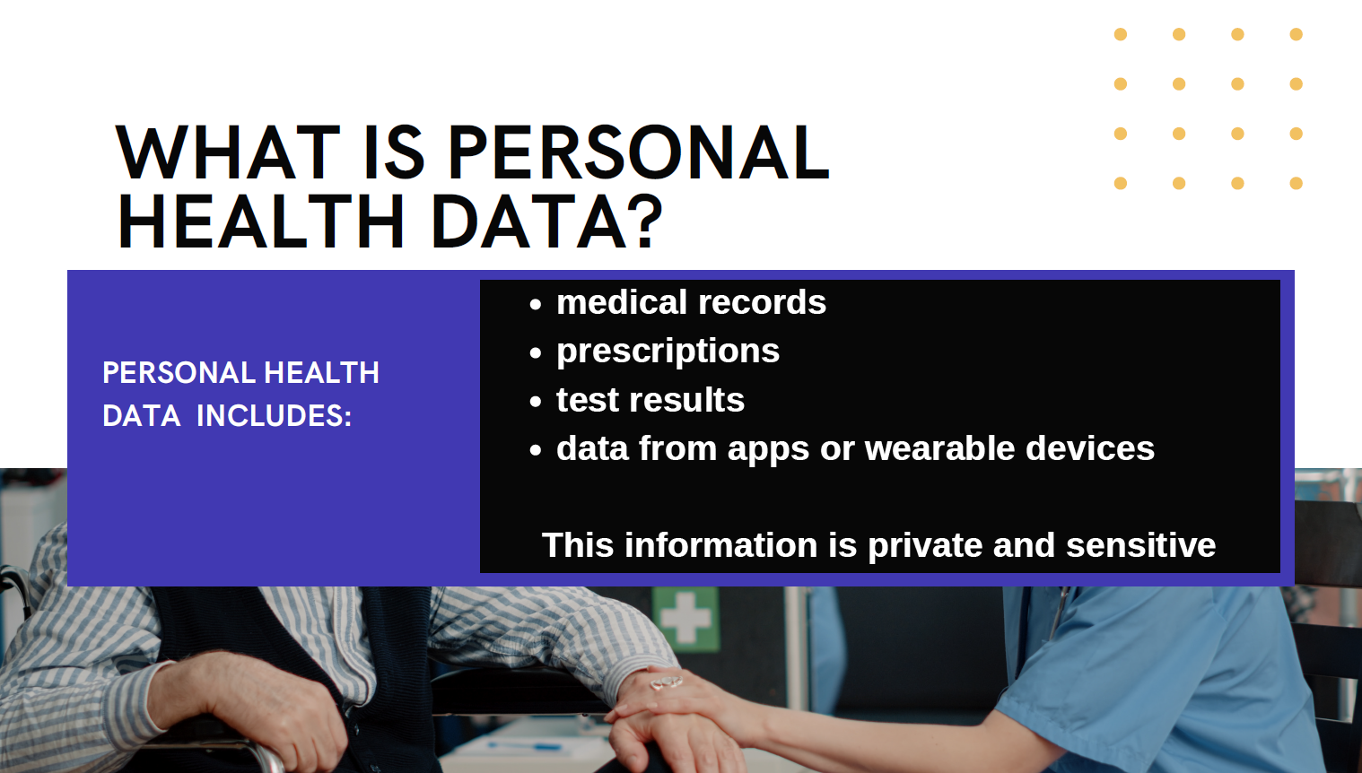

Slide 17
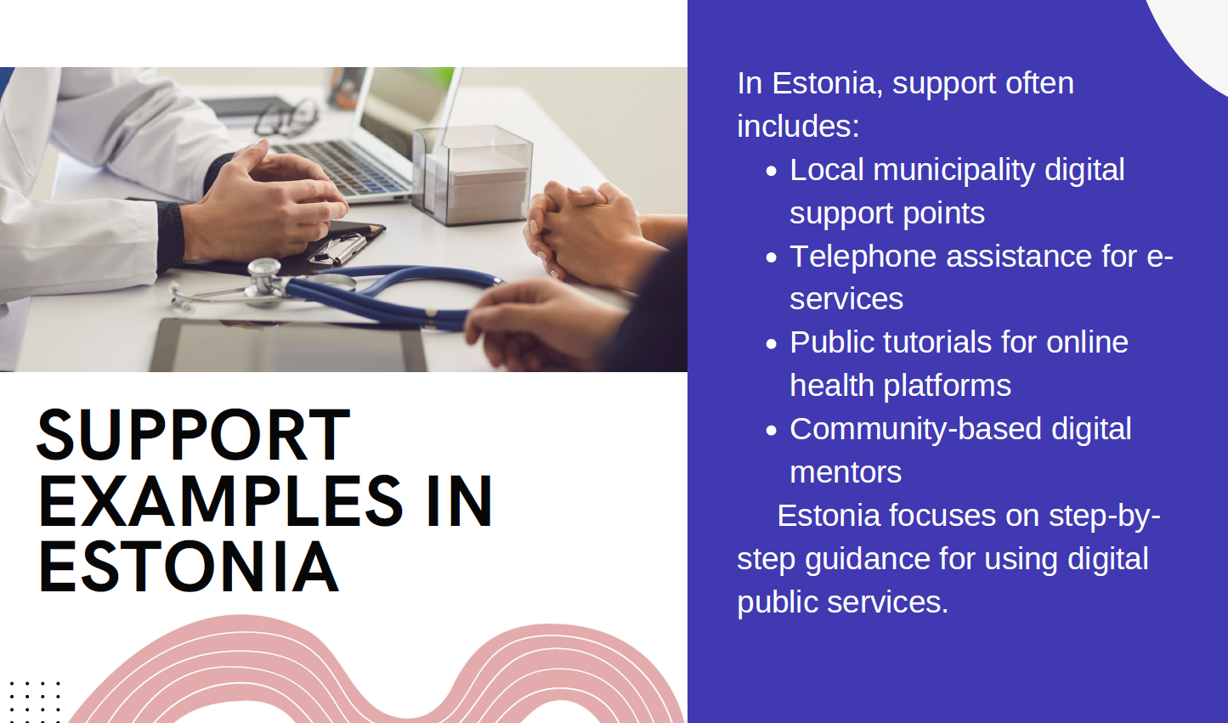

Slide 18


