Slide 1
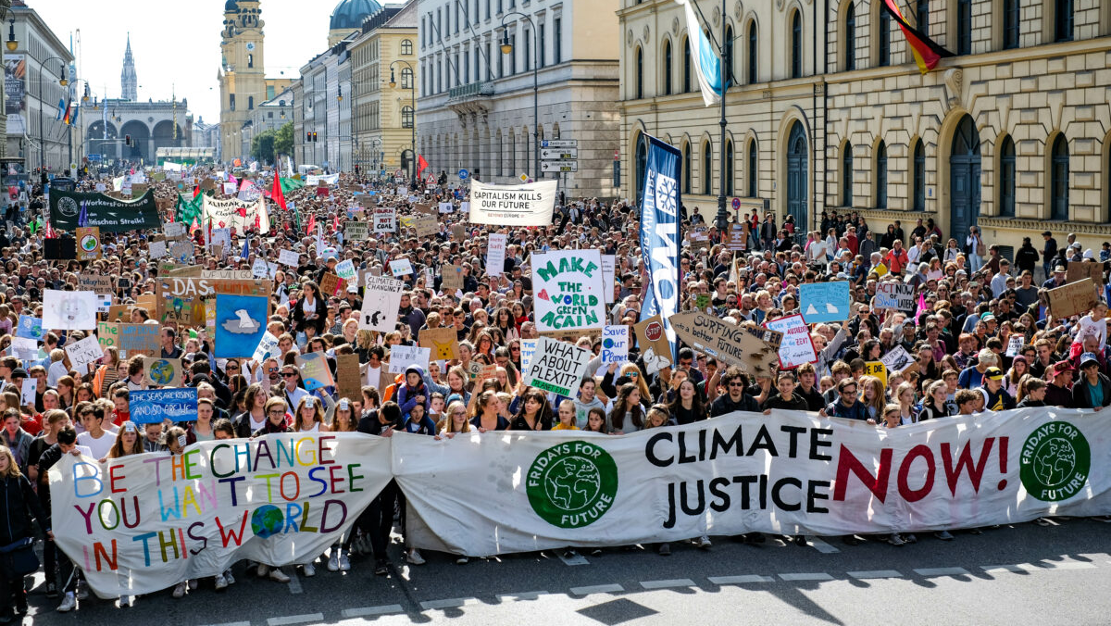
The role of young people and civil society organisations in fighting for sustainable development
Maris Pedaja, Estonian Green Movement

Slide 2
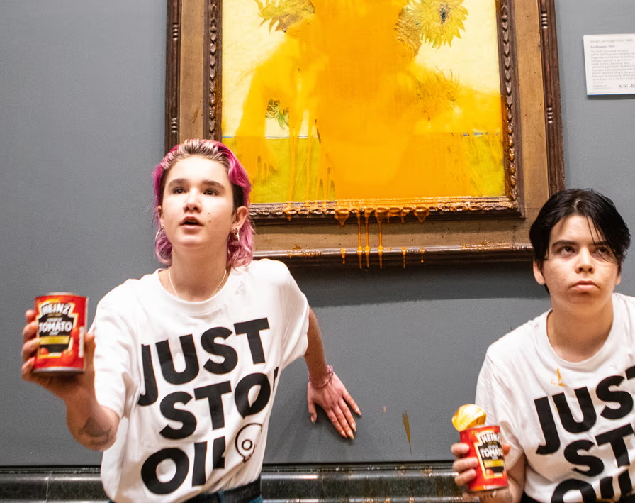
Do you recognise the photo?

Slide 3
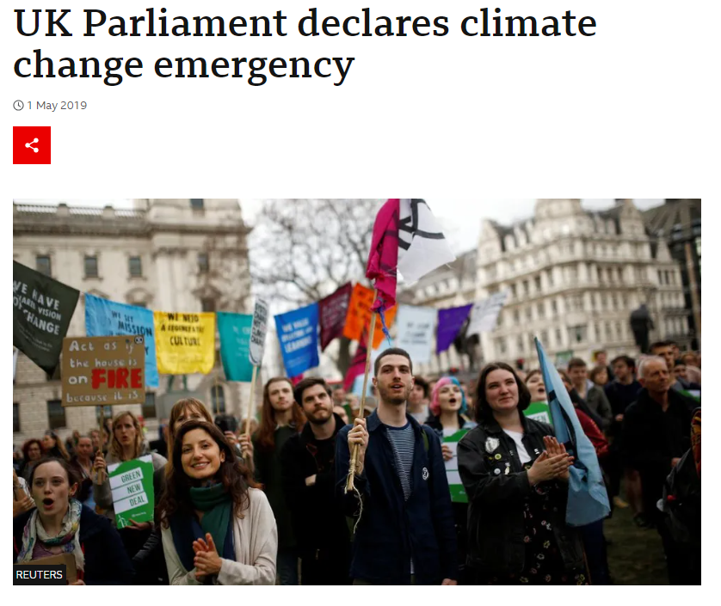
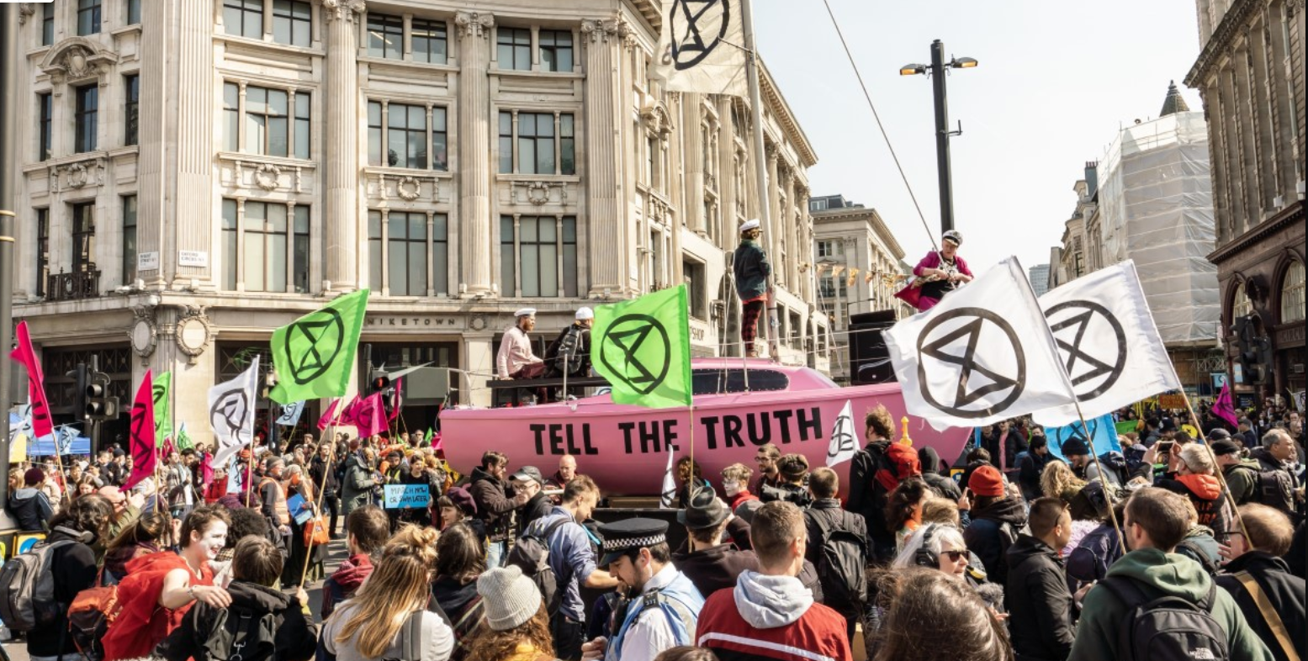
The role of civil society cannot be underestimated!

Slide 4
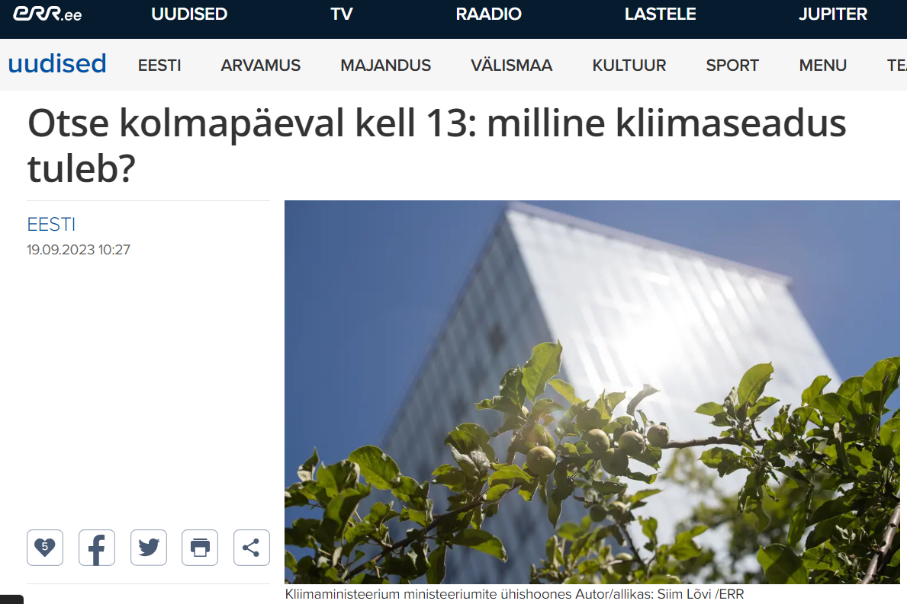
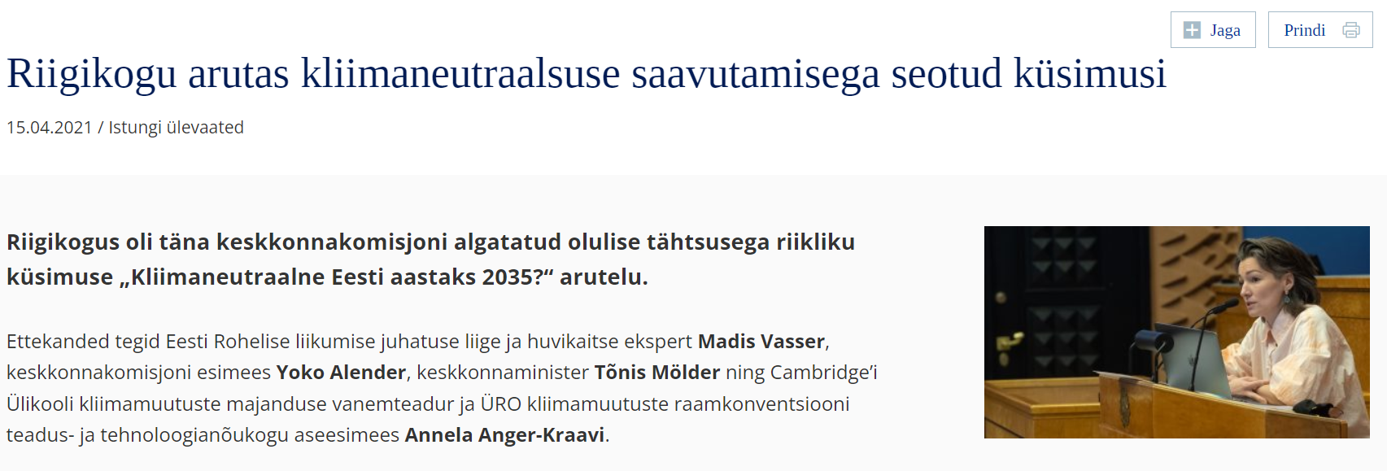
Civil society is pushing for higher ambition (case: ESTONIA)

Slide 5
Young people can shape the public narratives and policymaking

Slide 6
Main barriers
Wrong prioritisation: economic growth > environment
Overreliance on technological fix instead of structural reforms
Lack of political will: reducing overall production and consumption doesn’t sound politically attractive
Greenwashing: labeling environmentally harmful activities as „green“
Carbon tunnel vision: carbon politics prioritised over biodiversity protection despite the urgency of biodiversity crisis
Framing: negative connotation of „green transition“ in the eyes of some citizens and interest groups
NIMBY (not in my backyard) and climate denialist attitudes
Lack of inclusion: Environmental partners are often left out of key decisions
Notes:
Lack of inclusion: energy policy is highly technical and environmental partners are oftentimes left out of key decisions

Slide 7
The expectations of CSOs
Meaningful inclusion
Relying on science
Re-prioritising
Awareness-raising
Structural reforms
Wrong priorities
Overreliance on technology
Lack of political will
Greenwashing
Carbon tunnel vision
Framing
NIMBY / climate denialism

Slide 8
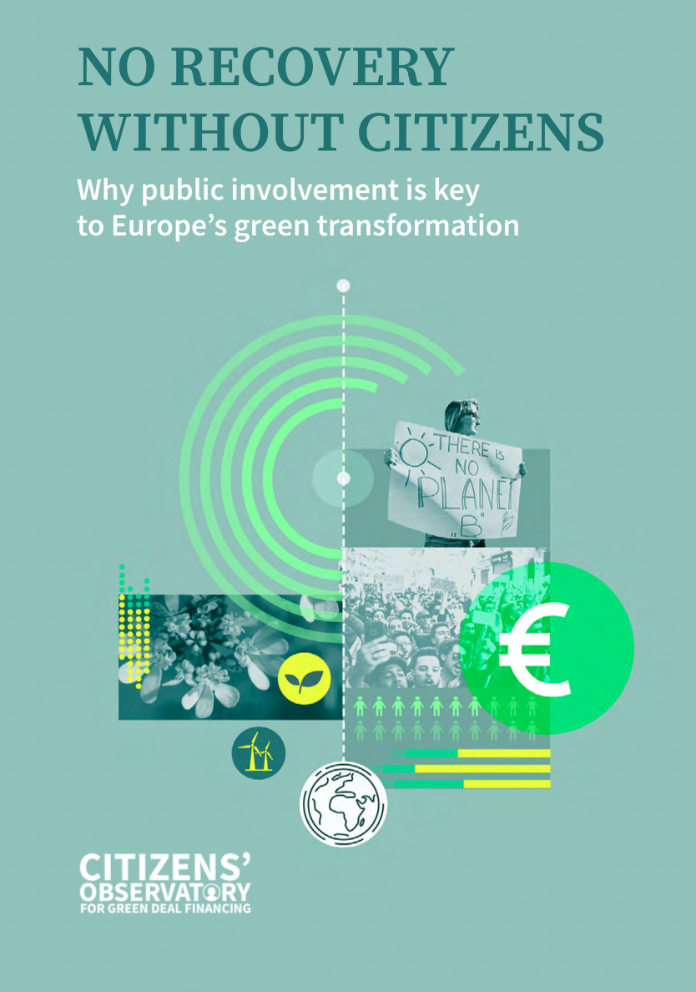
Thank you!
Maris Pedaja, Estonian Green Movement
maris@roheline.ee

